Slide 1

Bag of Visual Words (BoVW) classification
Module: C3
Group: 7
Students: Cristian Gutiérrez
Iñaki Lacunza
Marco Cordón

Slide 2
Index
Local Feature Descriptors
Dense SIFT
Clustering
Classification (k-NN & SVM)
Dimensionality Reduction (PCA & LDA)
Cross-validation
Spatial Pyramids (up to 4 levels)
ROC Curve
Precision-Recall Curve
Fisher Vectors (Optional)
Results Visualization
Conclusions

Slide 3
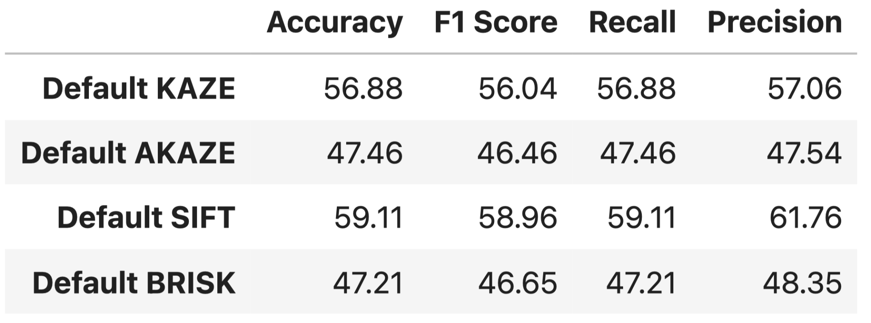
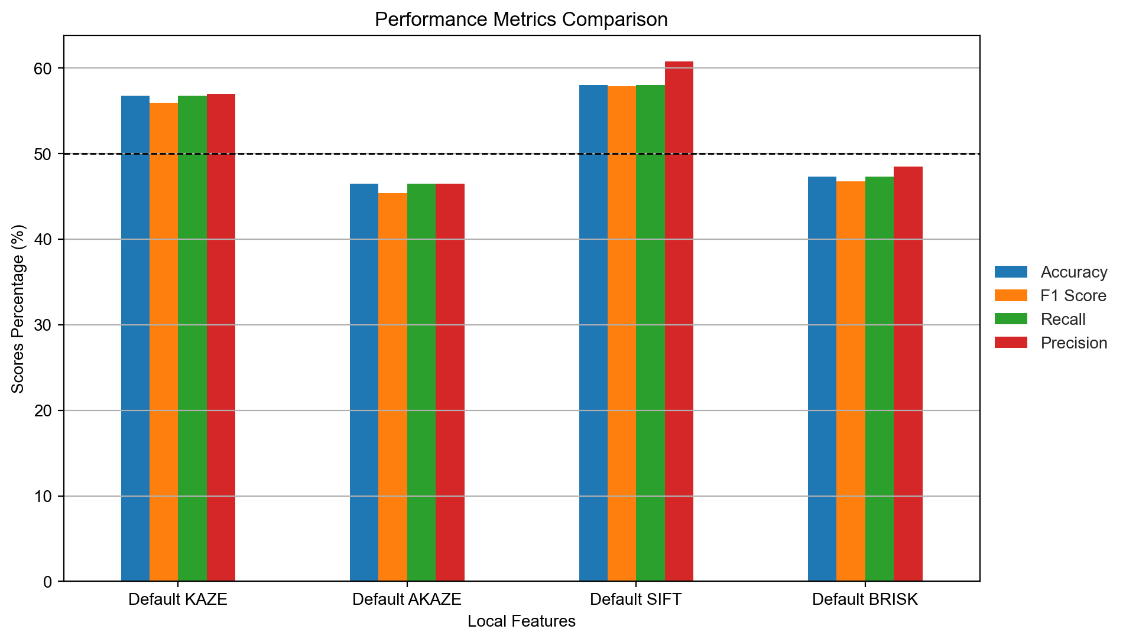
1. Local Feature Descriptors
We have used different Local Feature Descriptors, from the OpenCV [1] library.
In order to compare them effectively and in a fair manner, we used the default parameters to obtain different metrics (Accuracy, F1, Recall & Precision).
KAZE and SIFT with their default params are better than chance (>50%).
[1] Bradski, G. (2000). The OpenCV Library. Dr. Dobb's Journal of Software Tools.

Slide 4
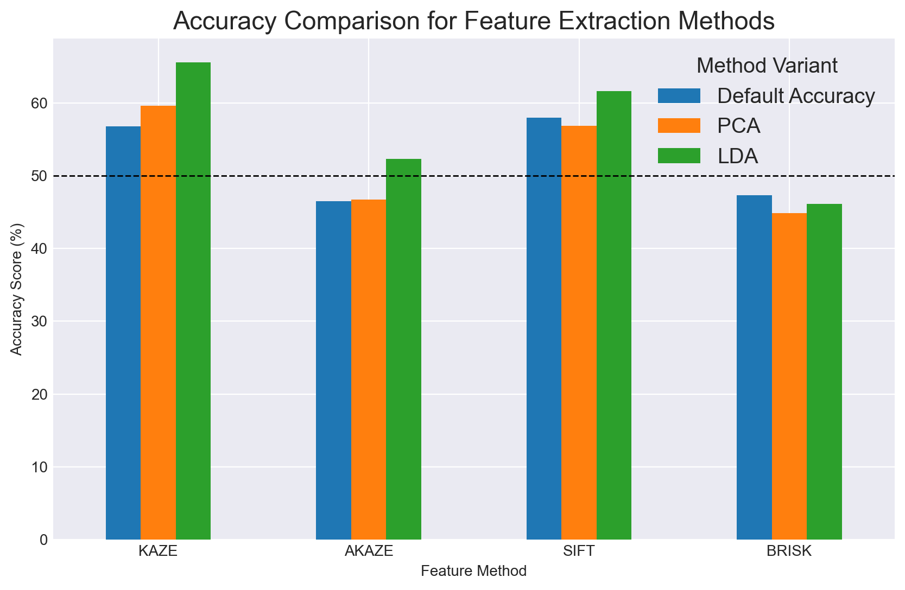
1. Local Feature Descriptors
Dimensionality Reduction
Furthermore, we tried applying dimensionality reduction with PCA and LDA and the results improved in some cases:
PCA n_Components = 69
LDA n_Components = 7
Even though, we still do not know the best `n_Components` parameter.

Slide 5
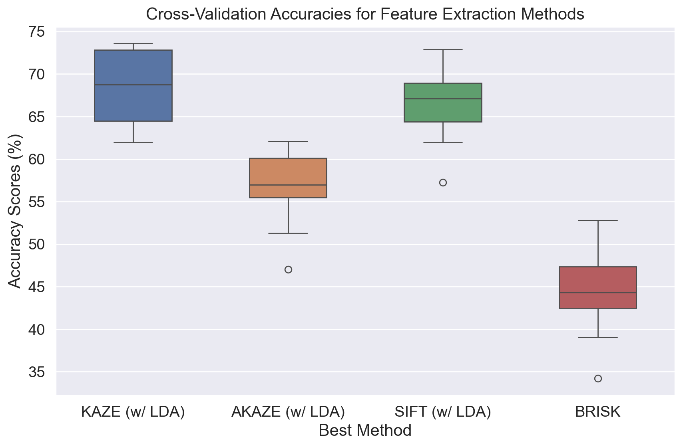
1. Local Feature Descriptors
Cross-validation Benchmark
We will use the best results obtained in the previous dimensionality reduction benchmark:
KAZE (w/ LDA)
AKAZE (w/ LDA)
SIFT (w/ LDA)
Brisk
* Important to notice that we perform cross-validation over the entire dataset, but the models are trained only with the training set.

Slide 6
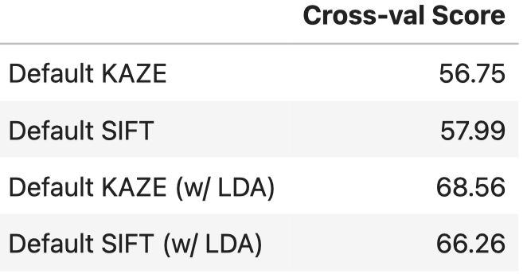
1. Local Feature Descriptors
To sum up:
We benchmarked the suggested Local Feature Descriptors with the default parameters to have a fair comparison.
KAZE and SIFT give the best results by default.
By adding LDA we increased our accuracy on KAZE and SIFT by 20.81% and 14.26% respectively.
We performed Cross-validation over the entire dataset with 10 folds (the models are still trained only with the training set.)

Slide 7
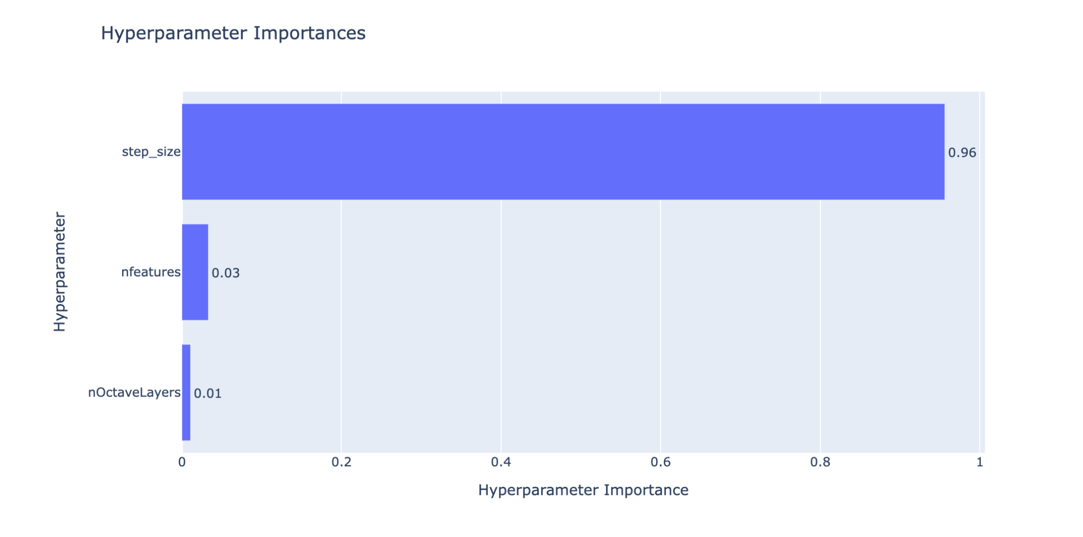
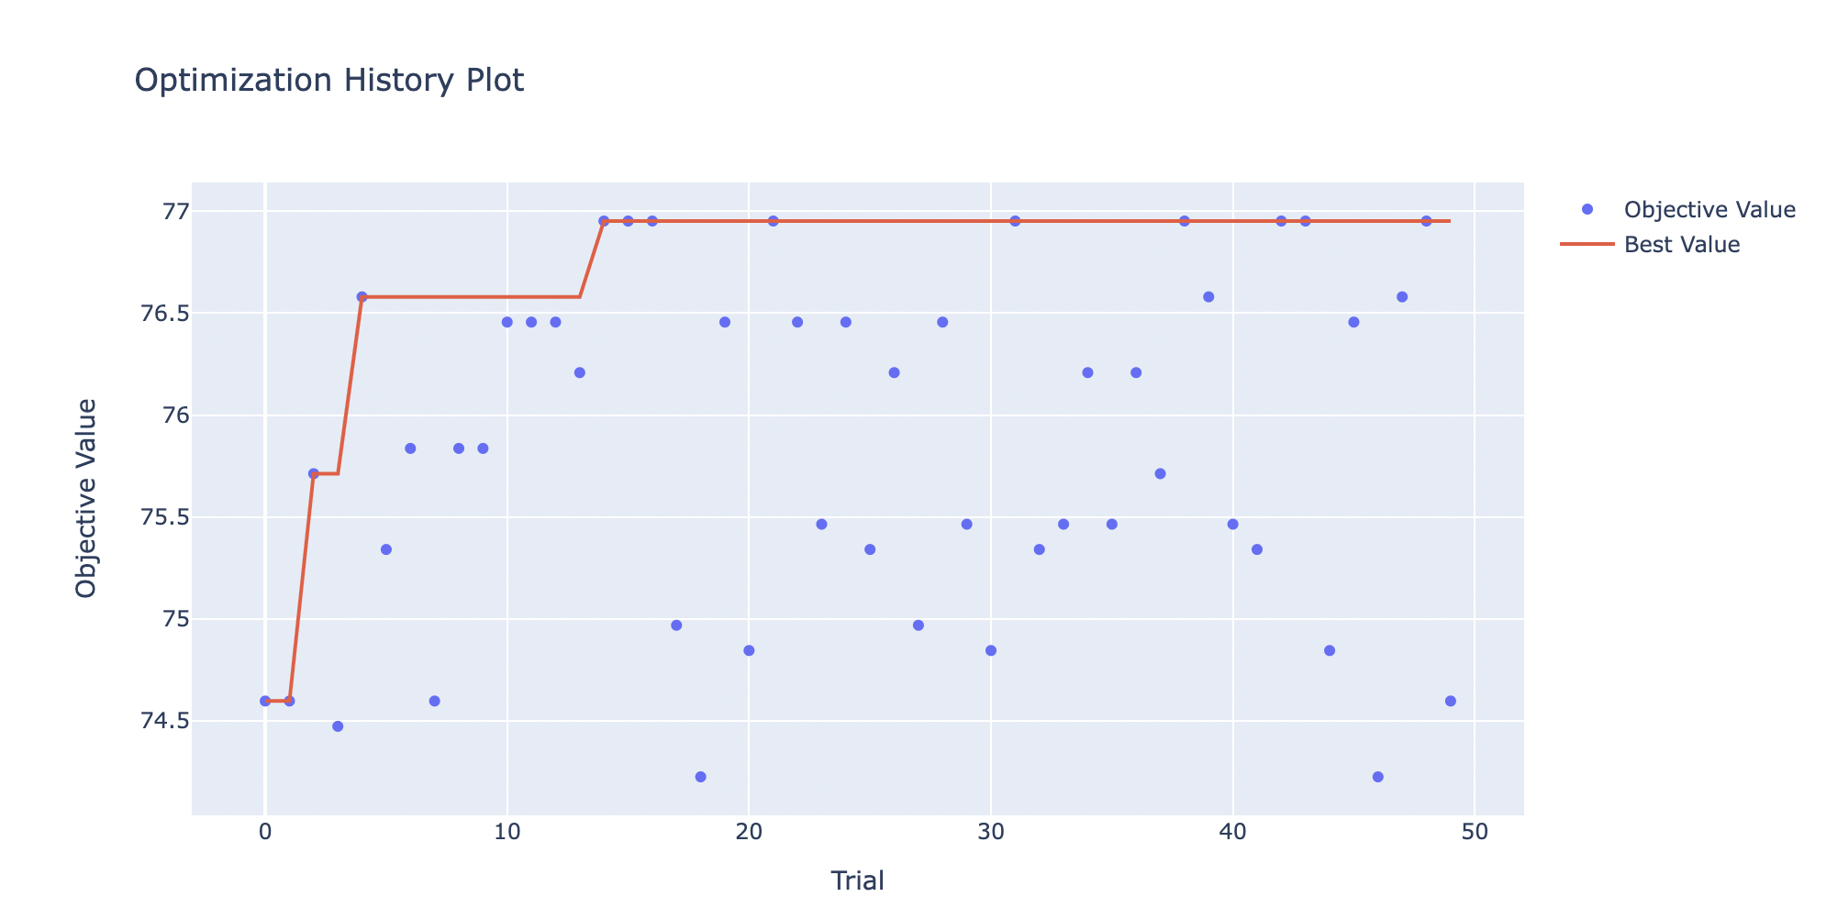
2. Dense SIFT (Hyper-parameter fine-tune)
We use Optuna [2] library for looking for the best Hyperparameters.
We will proceed to fine-tune the Dense SIFT Hyperparameters, we have the following params:
n_Features = 185
n_OctaveLayers = 2
step_size = 18
[2] Takuya Akiba, Shotaro Sano, Toshihiko Yanase, Takeru Ohta, & Masanori Koyama. (2019). Optuna: A Next-generation Hyperparameter Optimization Framework.

Slide 8
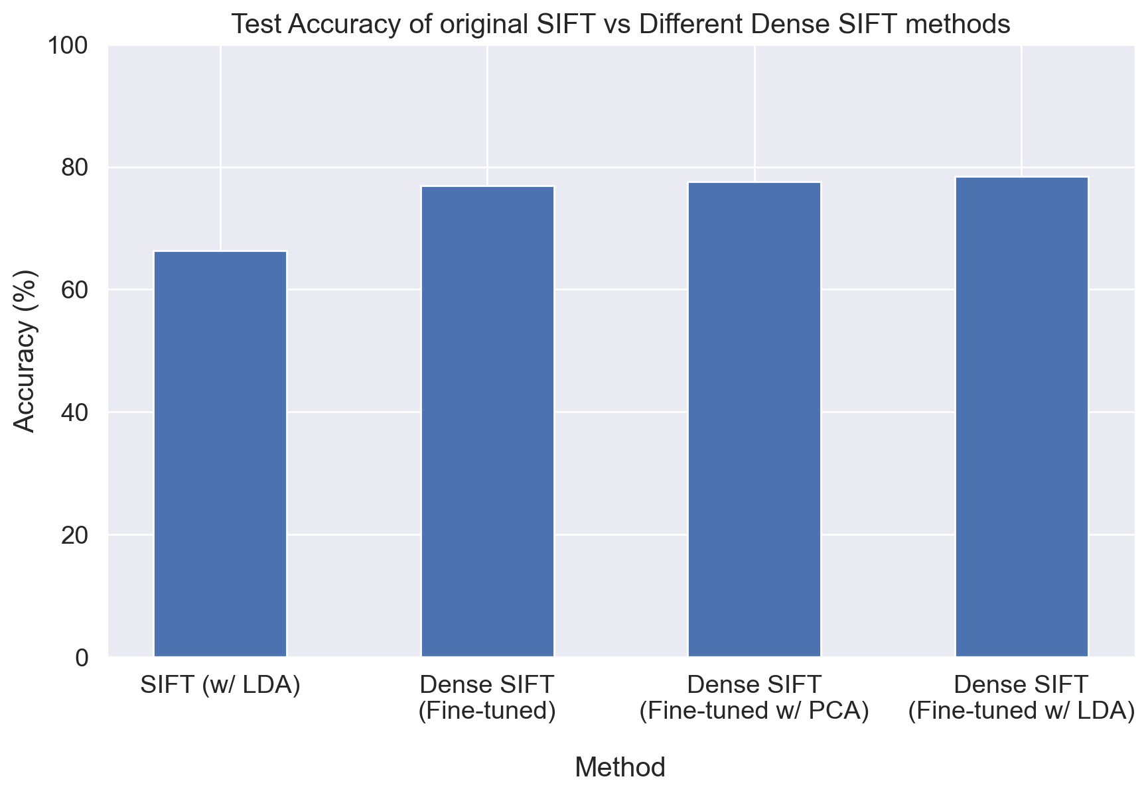
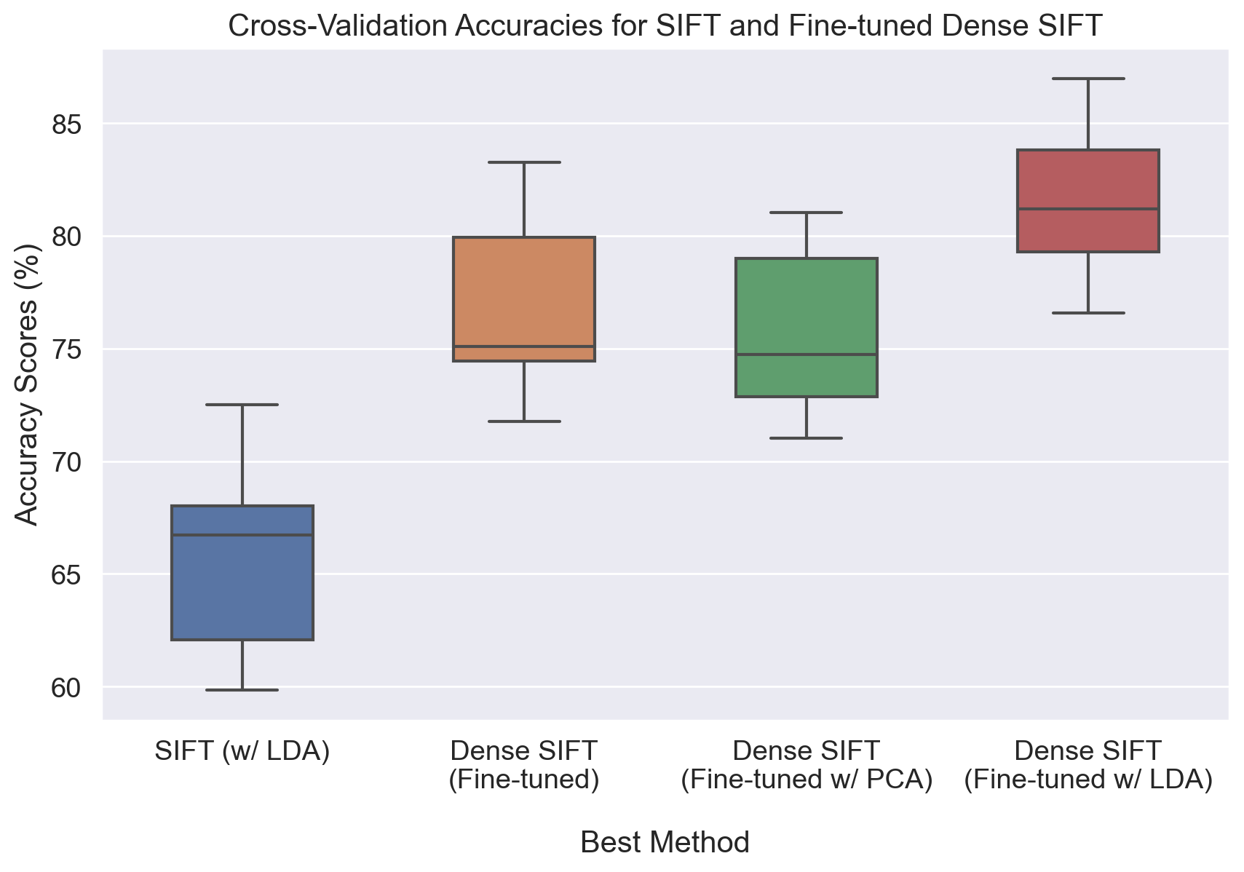
2. Dense SIFT (Hyper-parameter fine-tune)
We can see a great improvement of Dense SIFT with the Hyper-parameters fine-tuned with respect to the SIFT with LDA.
Test Accuracy
Cross-val Score

Slide 9
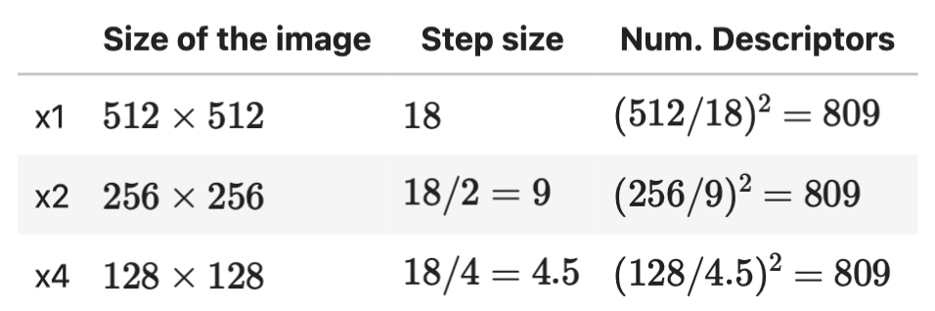
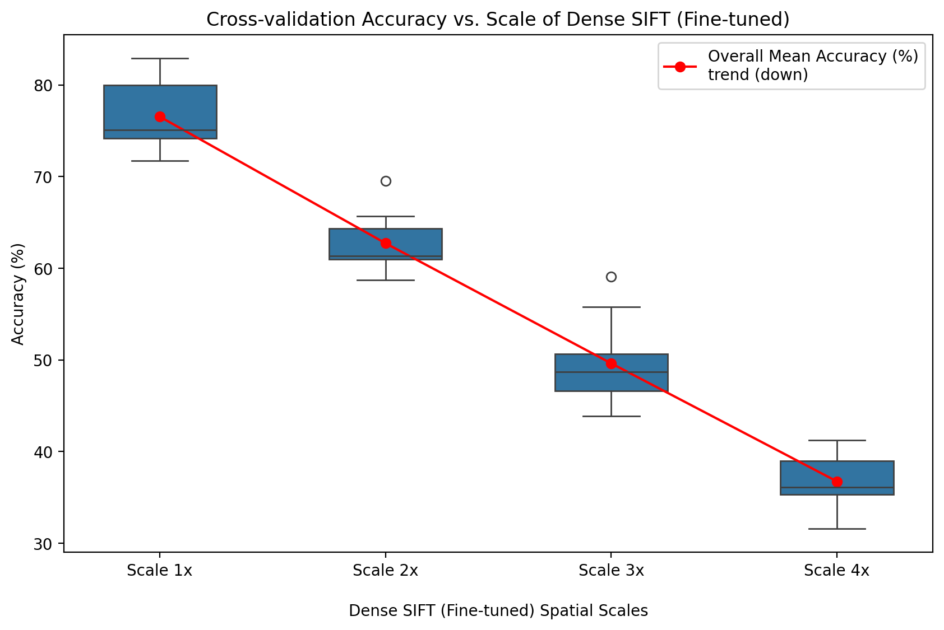
2. Dense SIFT
Different Scales
Using `x1`, `x2`, `x3` and `x4` scale factors that will:
Reduce the image by the scale factor of 2^{Scale-1}.
Adjust the Step size to obtain the same number of descriptors by each scale.
As we can see in the plot, the overall mean accuracy trend of increasing the reduction spatial scale is going down, hence, it has no positive effect for our model.

Slide 10
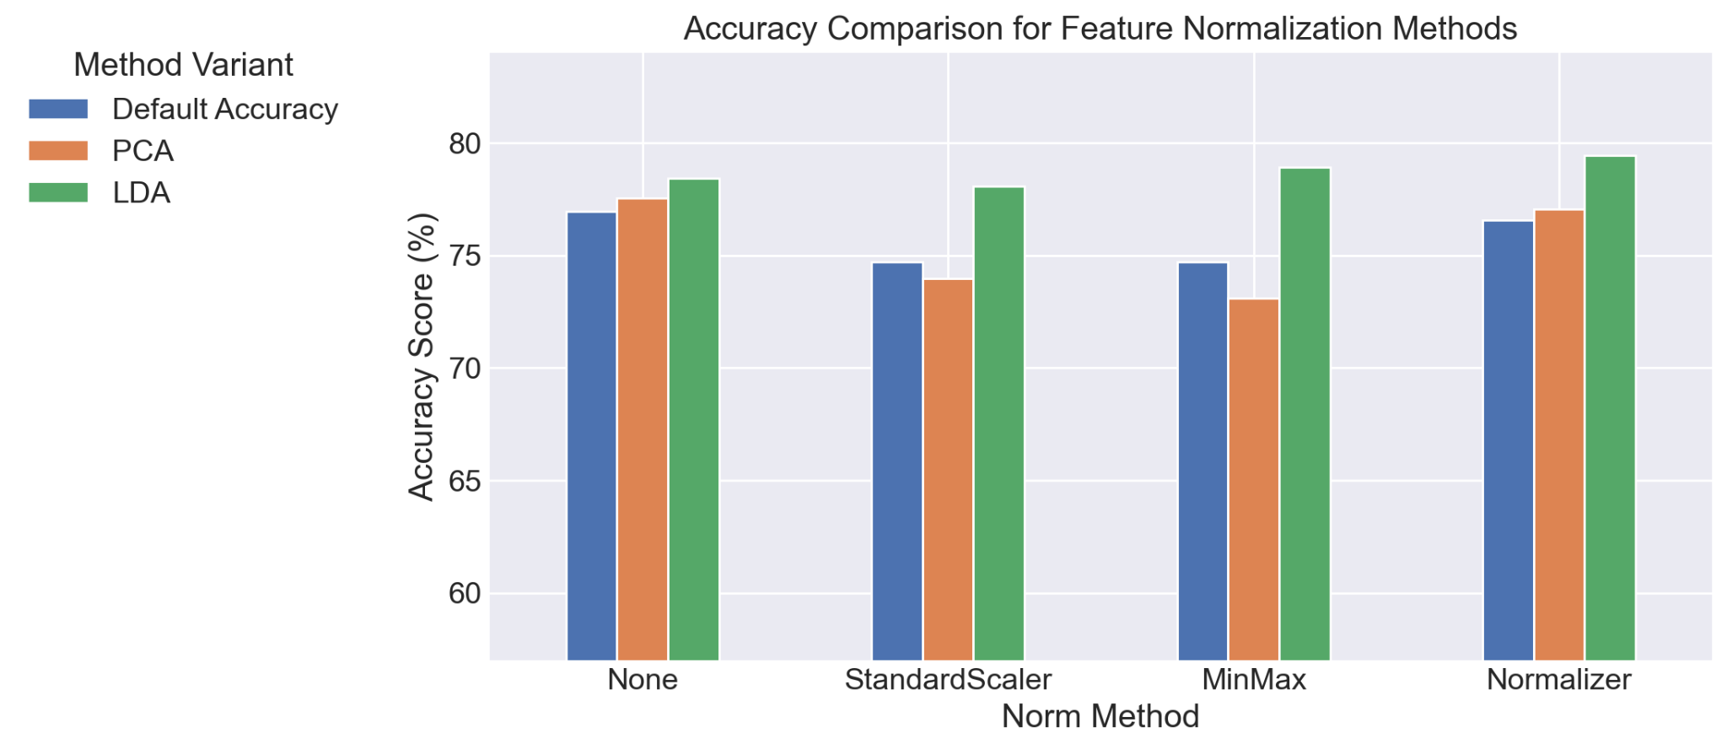
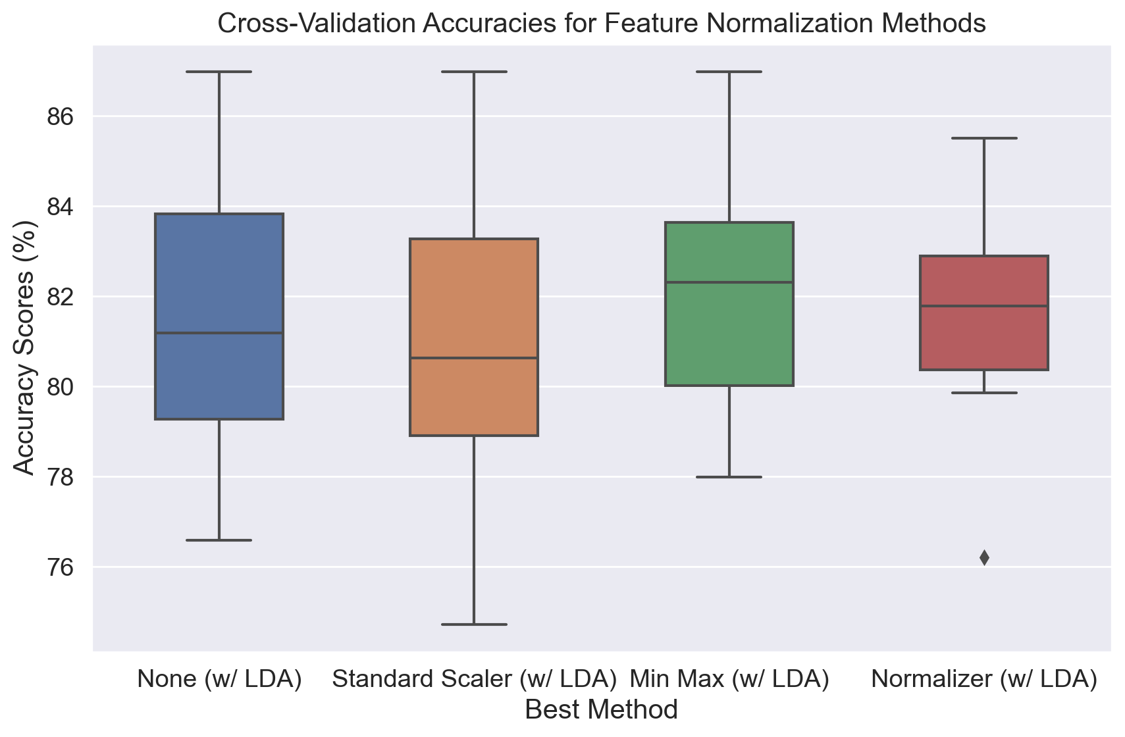
2. Dense SIFT
Feature Normalization
Scaler and Norms work well if, and only if, LDA is applied beforehand. The Test Accuracy points out that Normalizer is better, whereas the Cross-val Score points out that MinMax is the clear winner. (We will follow our cross-val score).
Test Accuracy
Cross-val Score
!!!!

Slide 11
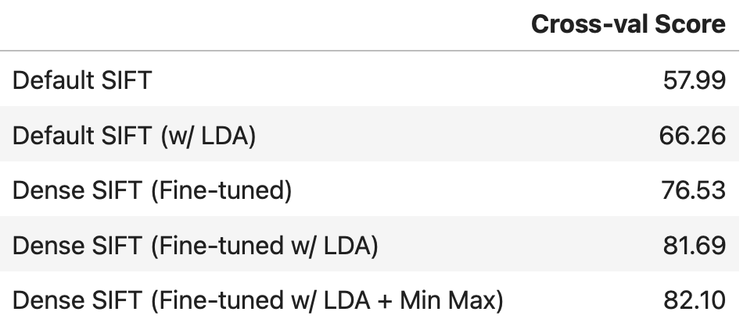
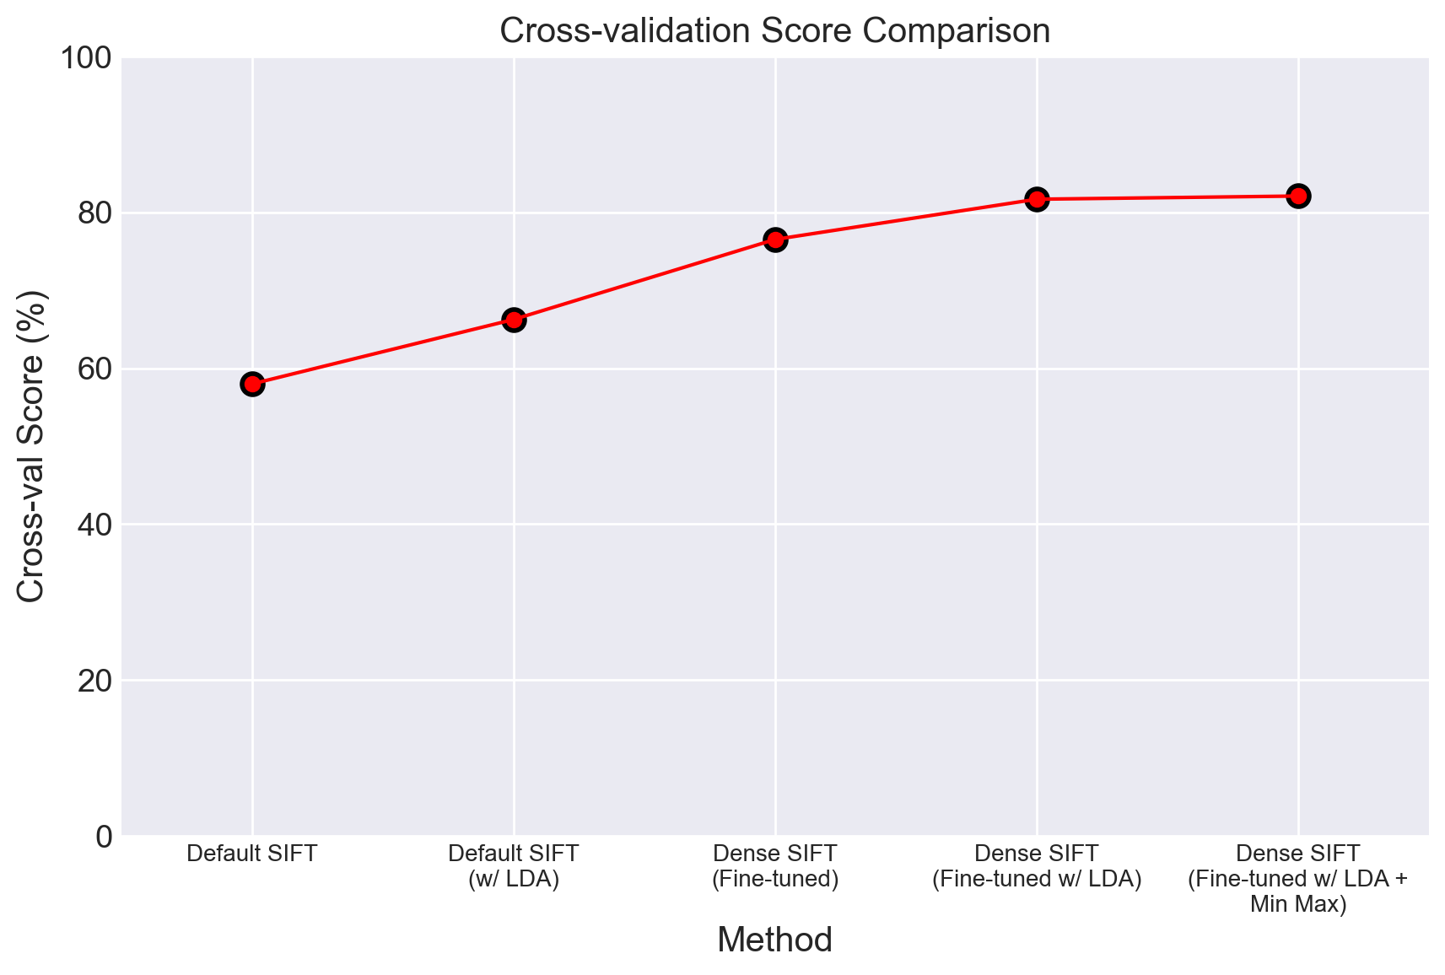
2. Dense SIFT
To sum up:
We fine-tuned Dense SIFT model and itself obtained better results than the best previous models (KAZE w/ LDA & SIFT w/ LDA).
Different scales do not work well.
Feature Normalization works well if, and only if, LDA is applied.
We cross-validated all results and follow their scores to decide enhances.
* If we notice the plot of the enhances implemented over time, seems like we are following a logarithmic trend and starting to have difficulties enhancing our cross-val score.

Slide 12
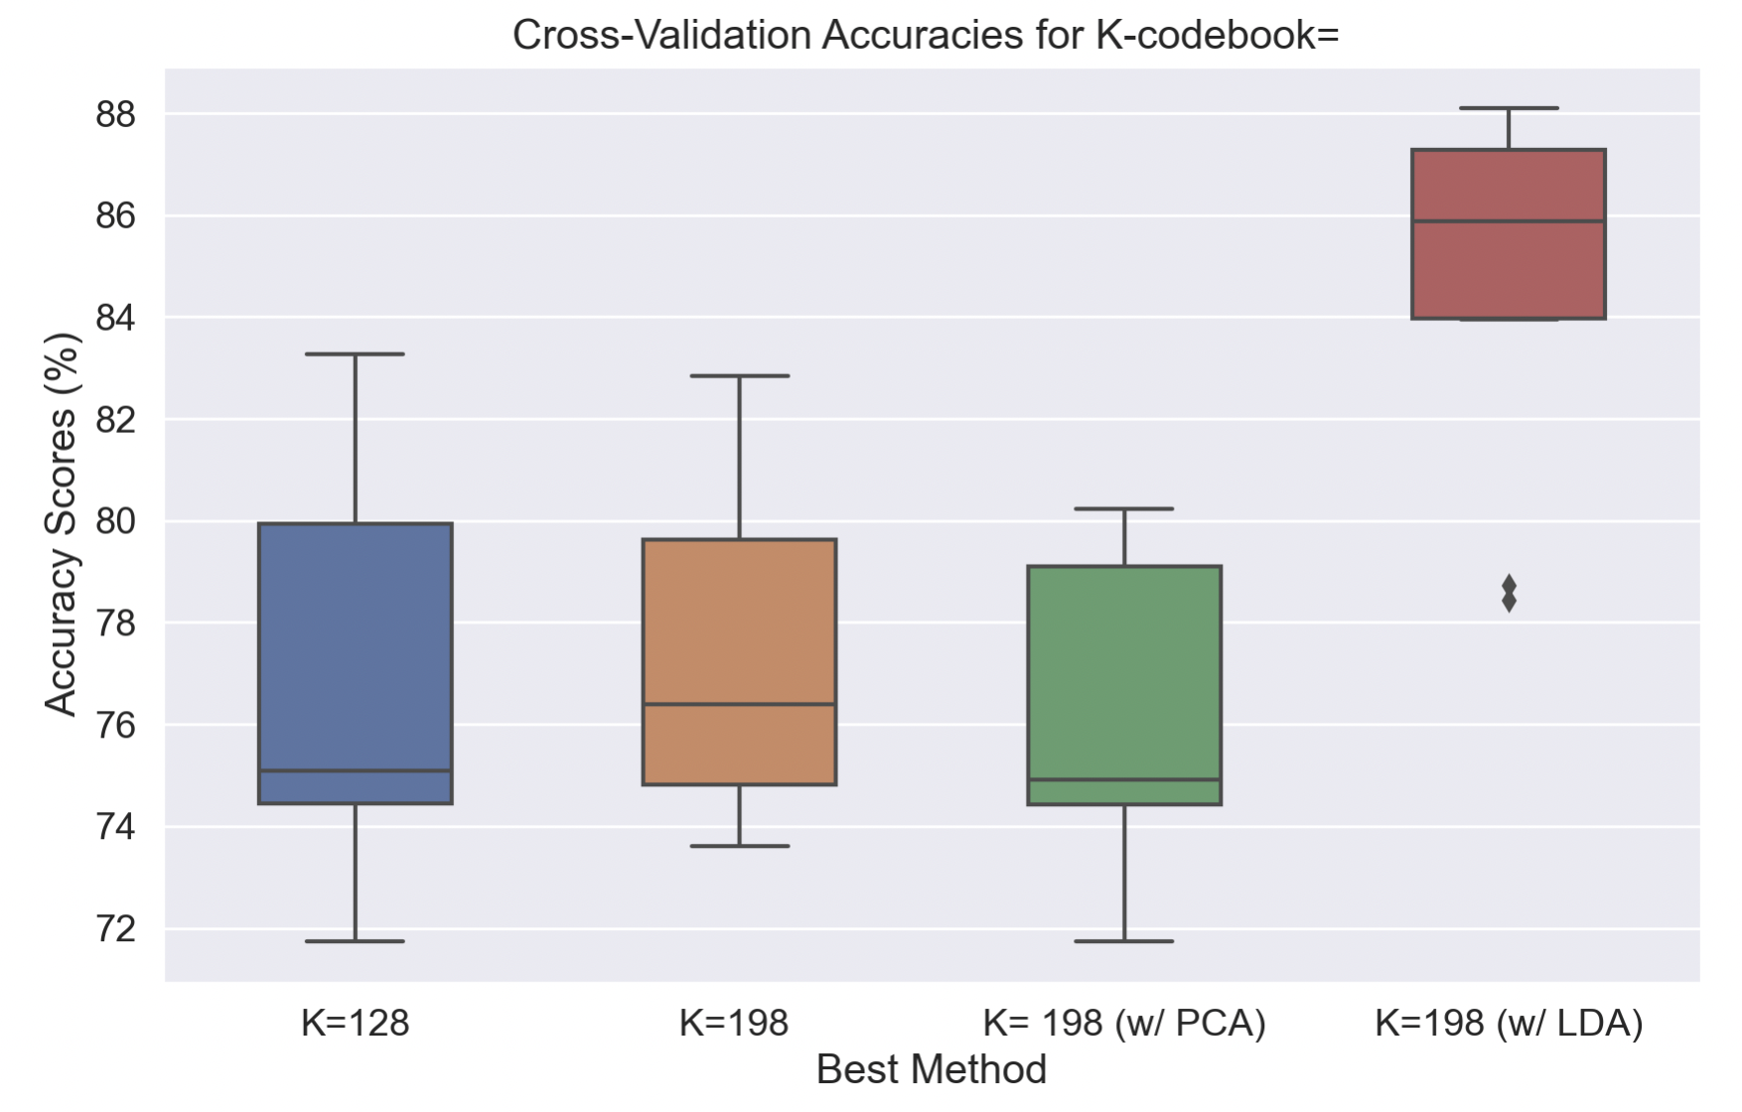
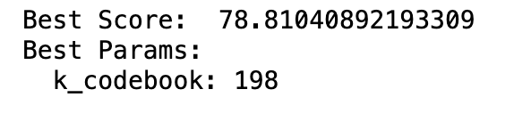
3. Clustering
Until now we are using a codebook size of 128 visual words, but we don’t know if that is the optimum value.
Again we use Optuna for looking for the best codebook size:
Once we know the optimum value we can apply a dimensionality reduction and comparing the results with a cross-validation.
We can see how the accuracy improves with the new value and how much better is the result with LDA.

Slide 13
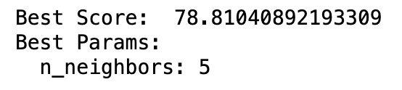
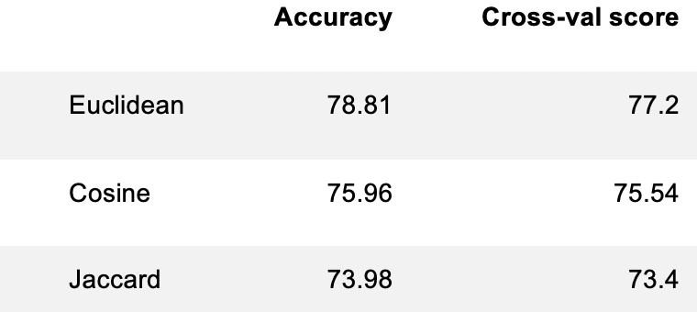
4. Classification (k-NN)
To apply the classification of the different images we have been using a K-Nearest Neighbors classifier. The original values employed was 5 neighbors and euclidean distance. But like in the previous point we don't know if they are optimum. For the number of neighbors we use again Optuna:
We obtain that we were using the optimum value. Now we try different distances:
After these different tries we have the certain that we were using the optimum values for the classifier.

Slide 14
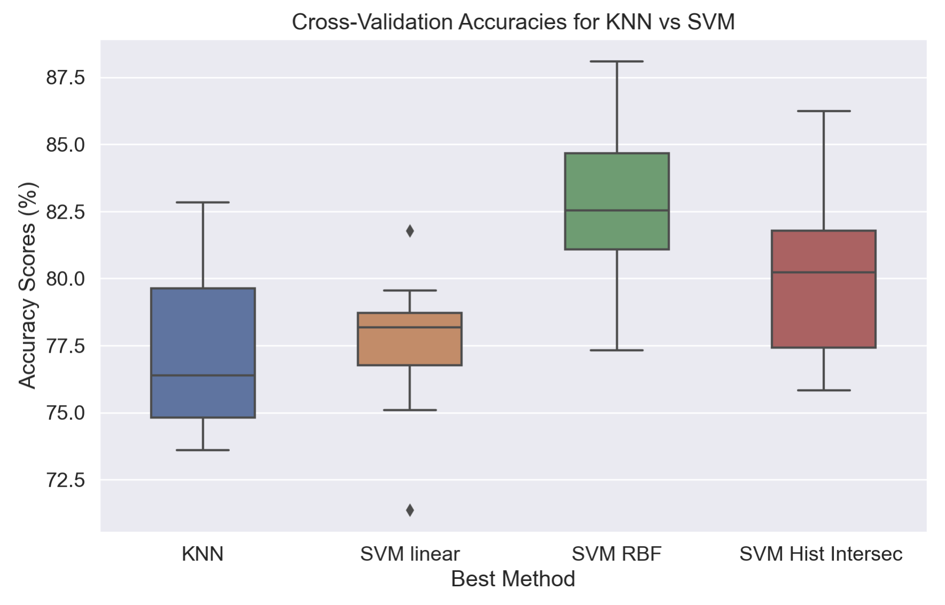
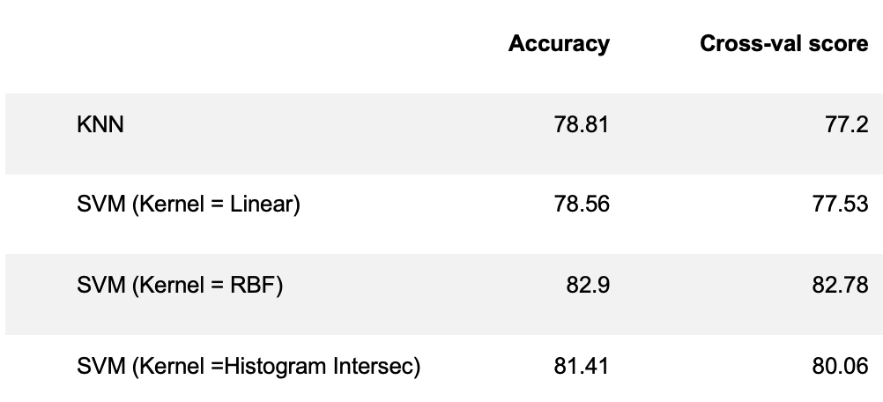
4. Classification (SVM)
We can try another classifier to know if we can reach better accuracy values. We use Support Vector Machine (SVM) classifier. We employ different kernels in the classifier to compare the results:
The SVM classifier with RBF kernel works better than KNN.

Slide 15
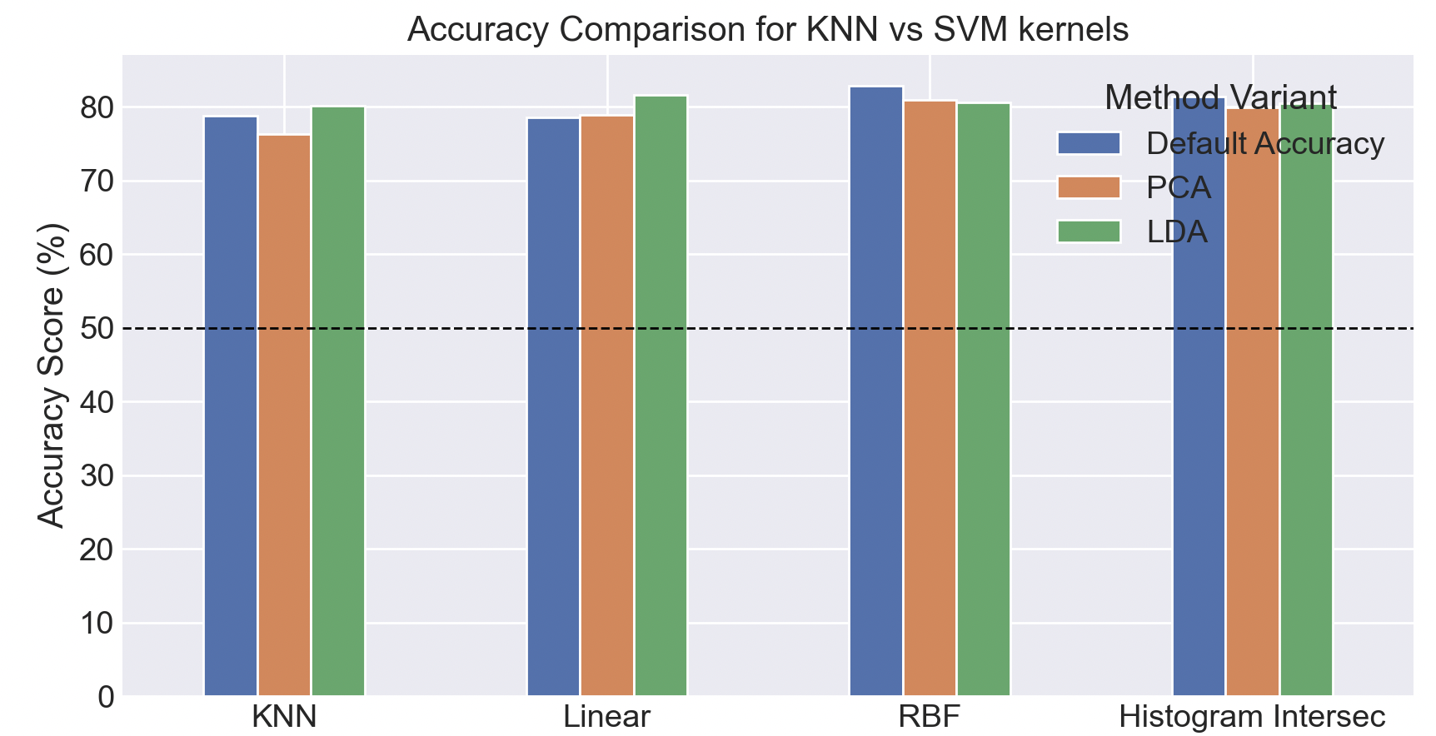
4. Classification (SVM)
If we reduce the dimensionality using PCA and LDA we obtain the follow results:
As we can see in the graph, the maximum value is obtained using SVM with RBF kernel and without reduce the dimensionality.

Slide 16
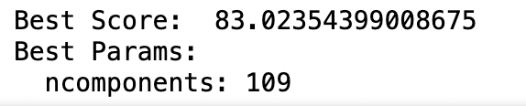
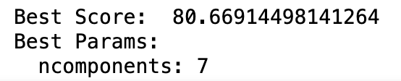
5. Dimensionality Reduction (PCA & LDA)
We have applied in all the previous steps a dimensionality reduction, using 2 methods: PCA and LDA. But we were using them with the same fixed parameters in all the steps. Again using Optuna we calculate the optimum values for the number of components of PCA and LDA:
PCA:
Before the optimization we were using components: 69 with an accuracy of 82.9, changing to 109 components we obtain a bit higher accuracy.
LDA:
In the case of LDA the optimum value is the same that the one that we were already using.

Slide 17
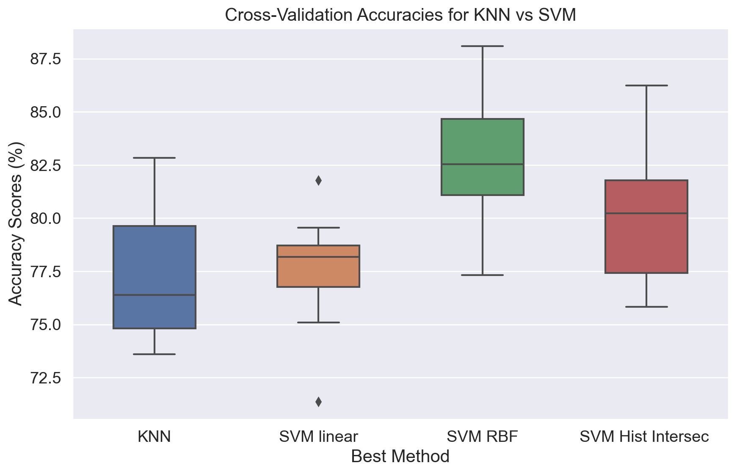
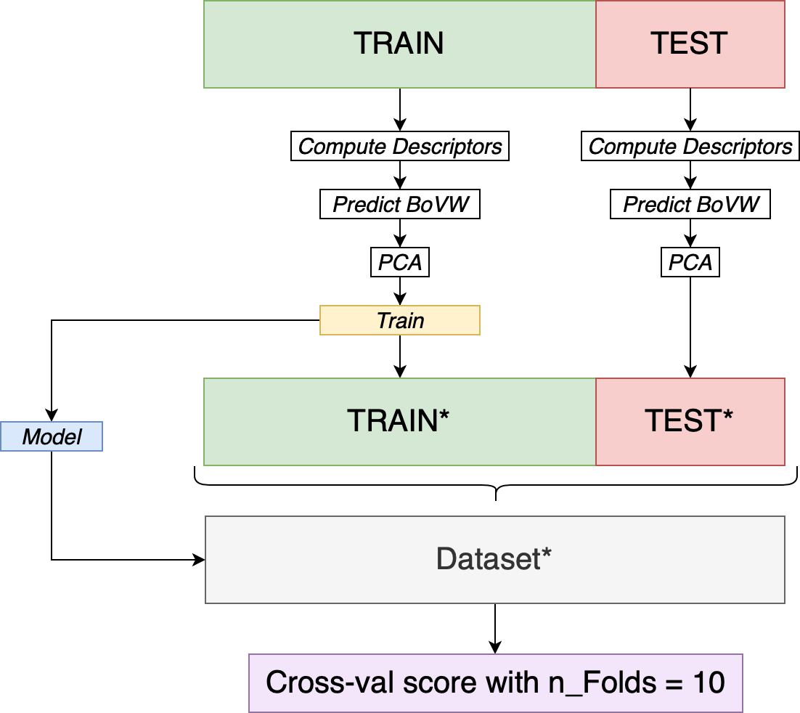
6. Cross-validation
Pipeline with integrated cross-val
We’ve been applying Cross-validation through the entire project, and we prioritized the cross-val score over the test accuracy score to decide which strategies to include in our fine-tuned model as it is a more reliable way for unseen data and observing if the model has generalized knowledge.
Important to notice that we perform cross-validation over the entire dataset, but the models are trained only with the training set.

Slide 18
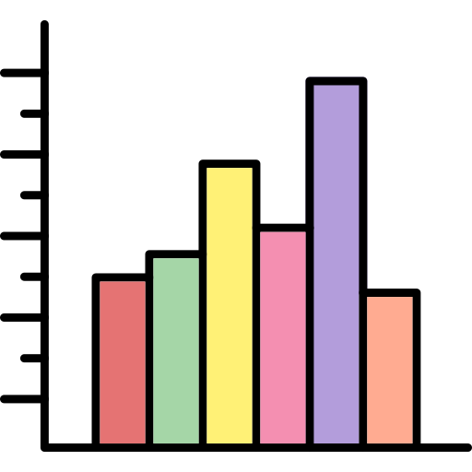
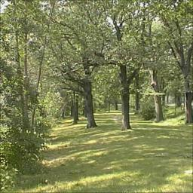
7. Spatial Pyramids
Like we are using Visual Words histograms we lose the spatial information about the localization of each Visual word. In order to recover this info we can use 'Spatial Pyramids'. We will crop the image in different parts and we will made visual word histograms of each part by separate. Finally we will concatenate all the histograms of each image to have more information about each image.

Slide 19
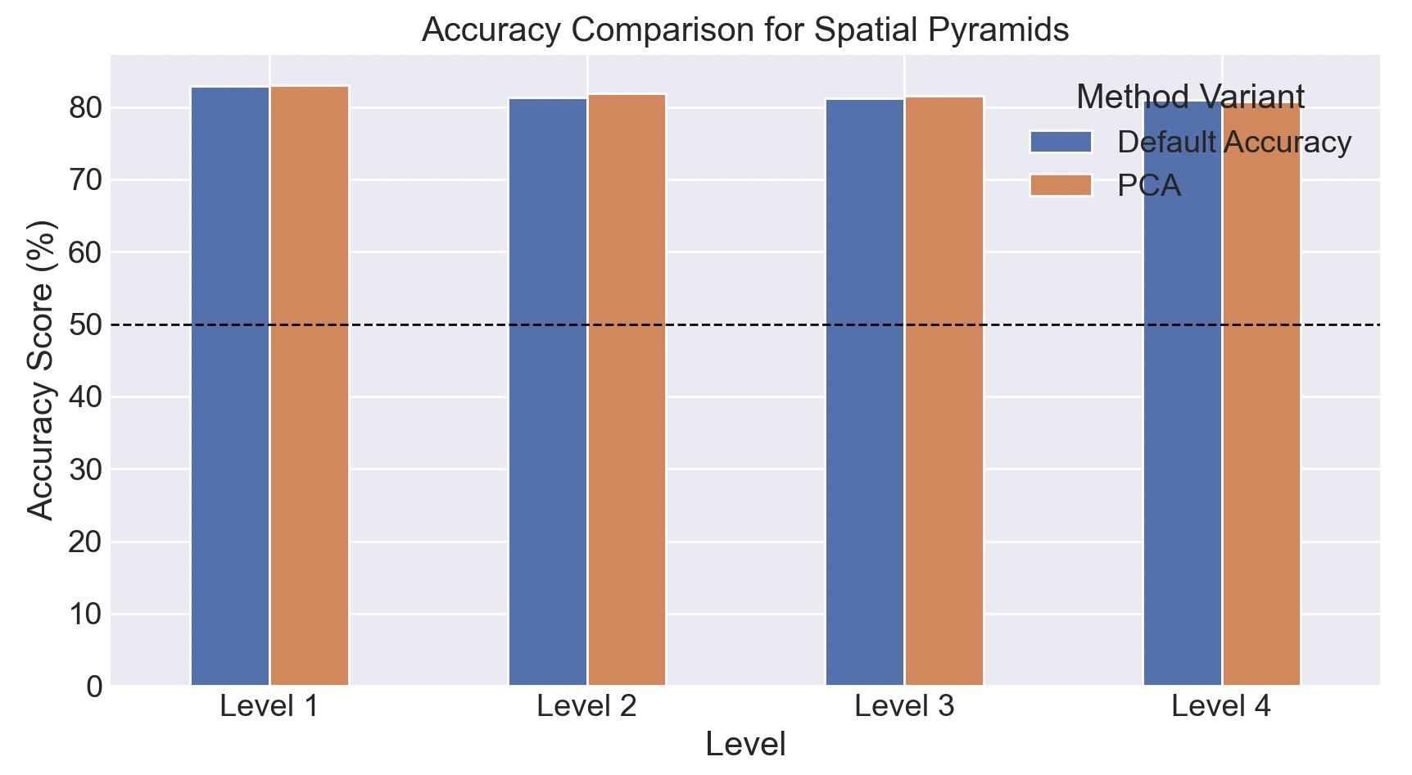
7. Spatial Pyramids
We apply this method at different levels, being the level 1 only an unique histogram and the level 4, 85 different concatenated histograms:
Surprisingly, the best results are obtained at level 1 where there is no zoning of the image. It could be that in our dataset the visual words are not always located in the same areas of the image and this method only introduces distortion.

Slide 20
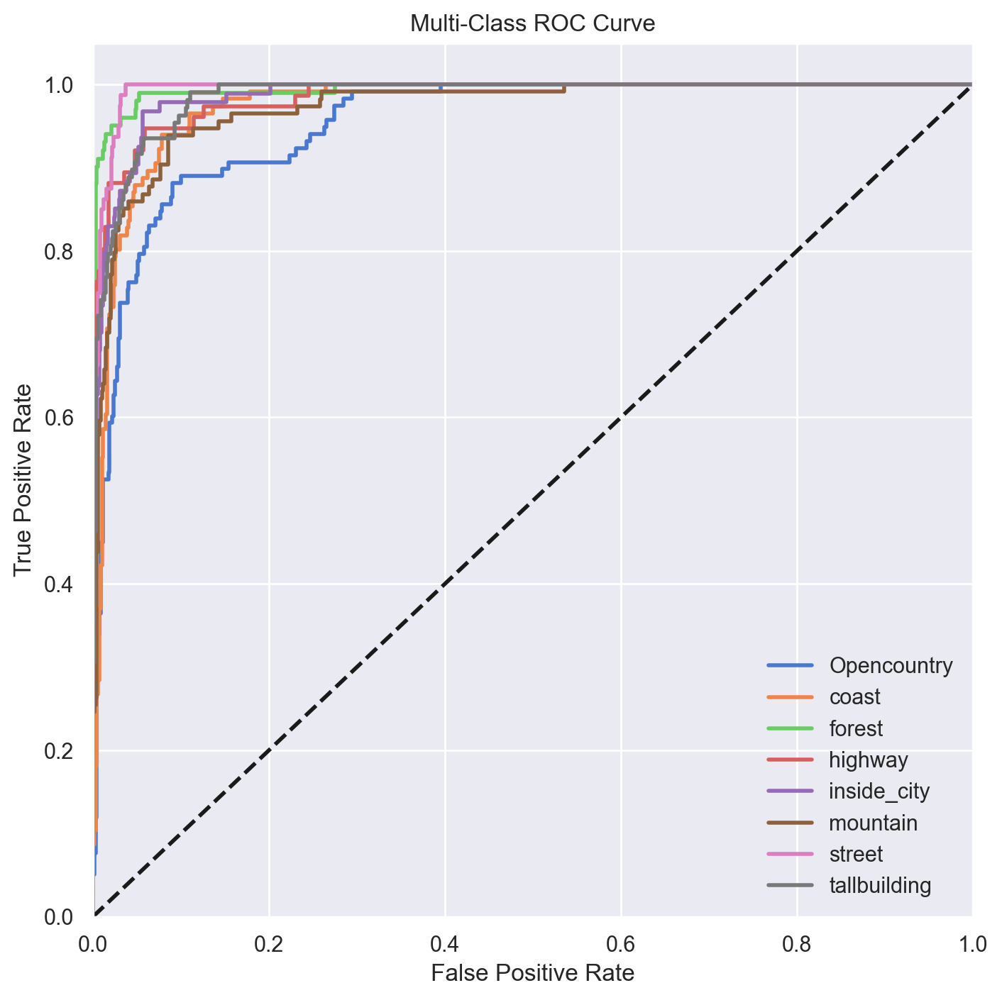
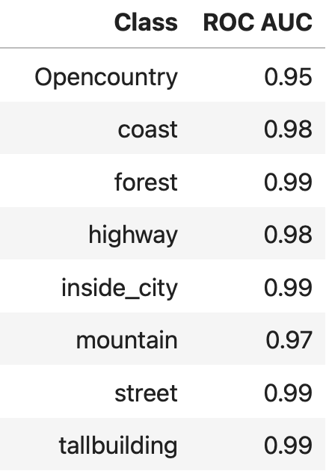
8. ROC Curve
With the Area Under the Curve (AUC) metric we see that it has `some` difficulties with the opencountry label, but overall it is a good classifier.
Because the curve is close to the top-left, indicates that we have a low FPR and a high TPR which is ideal for a classifier that can effectively separate each class form the others.
Good balance between sensitivity and specificity.

Slide 21
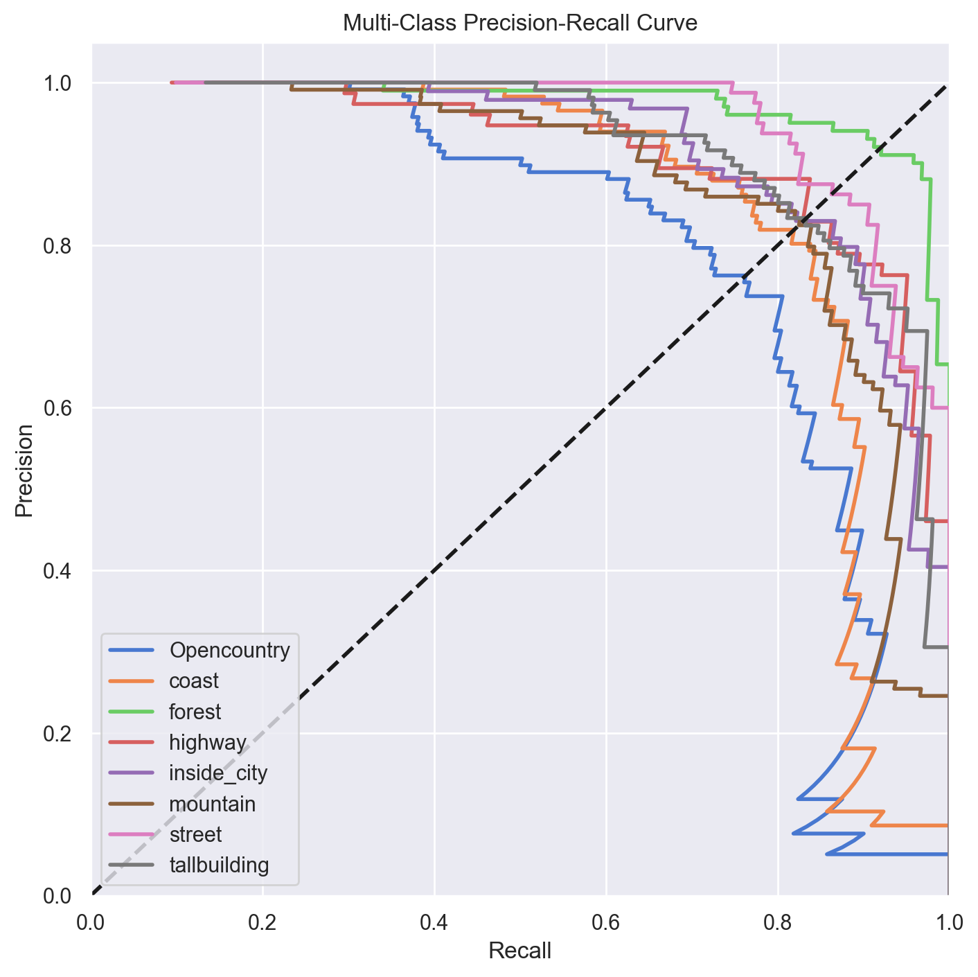
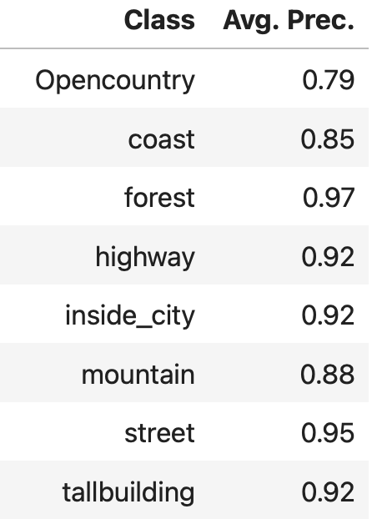
9. Precision-Recall Curve
By the Average Precsion (AP) we can see that the system is having difficulties with the Opencountry test label. We think the classifier is having problems with it because it is a rather general label, hard to distilish.
The contrast between the high ROC AUC and the relatively lower AP for the 'Opencountry' class implies that our model can effectively distinguish ‘Opencountry’ from the others (positive vs rest negative) but is somewhat failing to deliver precise results (presence of false positives).
To sum up, ROC AUC > Prec-Recall, hence, there is more room for improvement in the precision of our model rather than in the ROC.

Slide 22
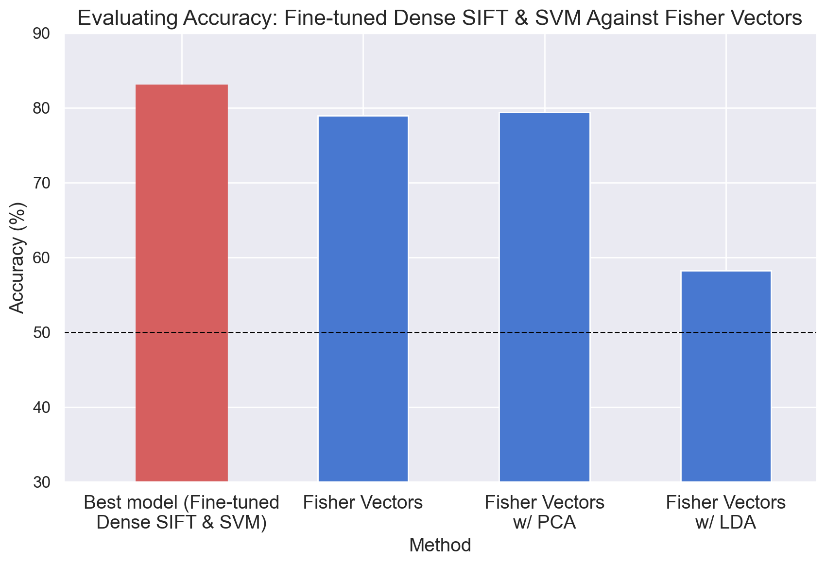
10. Fisher Vectors (Optional)
Fisher Vectors [3, 4] extend the Bag of Visual Words (BoVW) model by capturing more information about the distribution of the local descriptors, with the help of a Gaussian Mixture Model (GMM).
Extract local desc. (Dense SIFT)
Fit a GMM model
Fisher Vectors
Normalization (optional)
SVM classification pipeline
We avoid the Bag of Visual Words pipeline because Fisher Vectors themselves are good feature encoding representations.
* Some may argue that fisher vector approach allows for faster training but we do not found that to be true as we have to train a whole added GMM and use their parameters for the fisher vector representation.
[3] Sanchez, J., Perronnin, F., Mensink, T., & Verbeek, J. (2013). Image Classification with the Fisher Vector: Theory and Practice. International Journal of Computer Vision, 105(3), 222-245.
[4] Code based on Fisher Vectors python script from Dan Oneață: https://gist.github.com/danoneata/9927923/

Slide 23
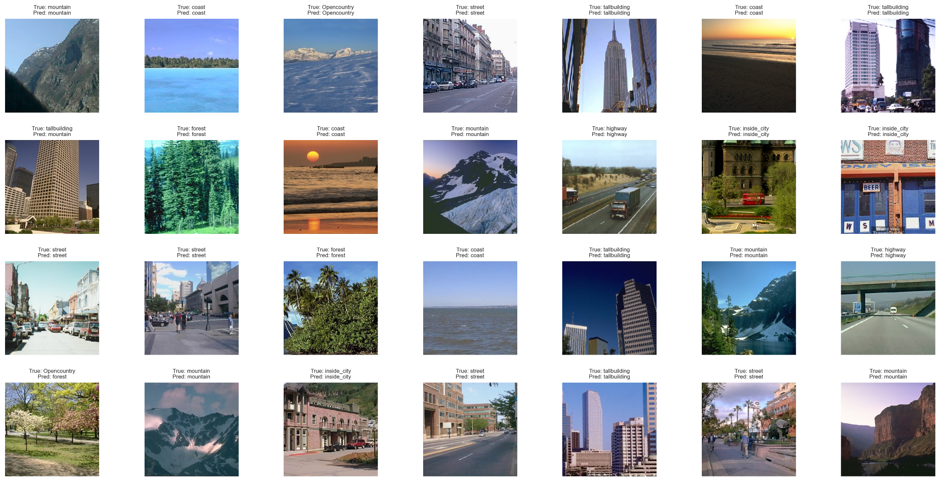
11. Results Visualization

Slide 24
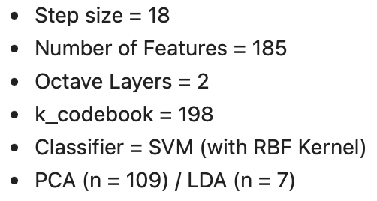
12. Conclusions
After all the experiments that we have done the parameters that give us the best result are:
Dense SIFT is an improvement by default, but also because the introduction of the new methodology, we have more parameters and therefore more opportunities to tune our model.
We cross-validated all the results and consider it a better metric to guide our decisions based upon the cross-val score because it has better reliability towards unseen data.
With the ROC and the Precision-Recall curves we can see that we have problems with ‘OpenCountry’ images due to the inherent ambiguity or diversity within this class. The major point for improvement is located at the Precision. However the overall results are pretty good.
In this dataset the localization of the descriptors doesn’t have much importance since neither the spatial pyramids nor the fisher vectors improves the results.

